Slide 1

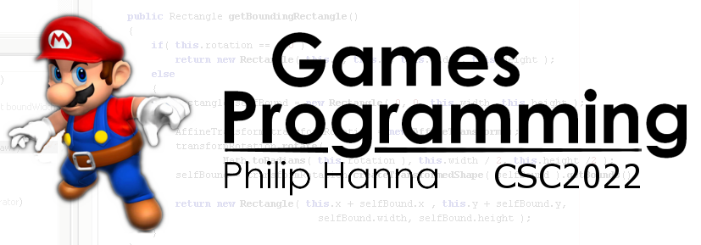
Pointers
All things pointer related
Part 2 – Use and Miscellanea

Slide 2

Pointers

Slide 3

Pointer Danger
When you create a pointer in memory it is allocated to hold an address but not the data to which the address points.
Such errors can produce unpredictable crashes that are extremely hard to trace back to the source problem.
1 | int *ptrSomewhere; // Unassigned
2 | *ptrSomewhere = 0; // Corrupt memory
Notes:
Pointer Danger
When you create a pointer in C++, the computer allocates memory to hold an address, but it does not allocate memory to hold the data to which the address points.
int *ptrSomewhere; // Create unassigned pointer;
*ptrSomewhere = 0; // Overwrite some random address in memory with zeros
This kind of error can produce unpredictable crashes that are extremely hard to trace back to the source problem.

Slide 4

The Arrow Operator
C++ offers the arrow operator (->) as a handy means of accessing members of a struct or a class through a pointer.
The following are all equally valid:
1 | struct Rec
2 | {
3 | int val;
4 | };
1 | Rec rec;
2 | rec.val = 20;
3
4 | Rec *ptrRec = new Rec;
5 | (*ptrRec).val = 20;
6
7 | Rec *ptrRec = new Rec;
8 | ptrRec->val = 20;
Using -> is often more convenient and more readily understood
Notes:
C++ offers the arrow operator (->) as a handy means of accessing members of a struct or a class through a pointer.
Assume a struct (or class):
struct Rec
{
int val;
}
The following are all equally valid:
Rec rec;
rec.val = 20;
Rec *ptrRec = new Rec;
(*ptrRec).val = 20;
Rec *ptrRec = new Rec;
ptrRec->val = 20;
The later offers a more convenient (and clear) means of accessing structs or classes through pointers;

Slide 5
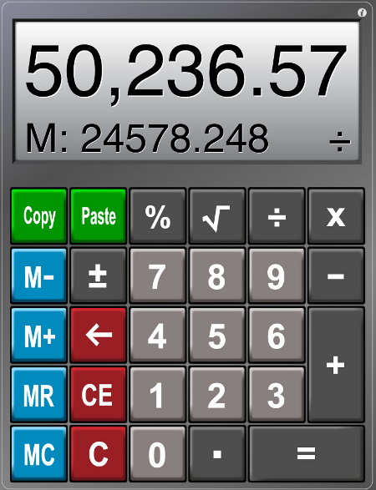
Pointers are not integers even if addresses are numeric (e.g. it doesn’t make sense to divide one pointer by another).
Some operations do, however, make sense:
Add or subtract a number (+, -, ++,--) to step the pointer forward or back in memory.
Comparing one pointer to another (==, !=, <, >, etc.)
Notes:
Pointers are not integers – even though we often think of an address as an integer number. For example, it doesn’t make much sense to divide one pointer location by another, although some arithmetic operations do make sense when using pointers.
For example, it makes sense to add or subtract numbers to pointers as a way of changing the referenced address (and thereby stepping through memory) (this includes the increment and decrement operators, ++ and -- ).
Addresses can also be compared using any of the relational operators such as == != < > , etc.

Slide 6
When adding or subtracting numbers to a pointer the pointer steps not in terms of bytes but rather in terms of whatever is pointed to.
1 | int *ptrInt = array[0]; // Assume address 1000
2 | ptrInt += 3; // Steps pointer by 3 ints
3 | // = 1000+3*sizeof(int)
4 | // = 1012 (and not 1003)
This makes pointers much easier to manipulate in terms of stepping through arrays.
Aside: Note *ptrVal++ is often used.
1 | *ptrVal++ // Use value and then increment pointer
2 | *++ptrVal // Increment pointer and then use value
3 | *ptrVal-- // Use value and then decrement pointer
4 | *--ptrVal // Decrement pointer and then use value
Notes:
When adding or subtracting numbers to pointers the pointers steps not in terms of bytes but rather in terms of whatever is pointed to. Hence.
int *ptrInt = someIntArray[0]; // Assume the address pointed to be ptrInt is 1000
ptrInt += 3; // Steps the pointer by 3 integers (e.g. the address is now 1000 + 3*sizeof(int) = 1012 and not 1003
This makes pointers much easier to manipulate in terms of stepping through arrays.
Aside:
*ptrInt++ // use the pointed-to value and then increment the pointer (commonly used)
*++ptNum // increment the pointer and then use the pointed-to value
*ptNum-- // use the pointed-to value and then decrement the pointer
*--ptNum // decrement the pointer and then use the pointed-to value

Slide 7

Here there be monsters:
When performing arithmetic on pointers great care must be taken to ensure that the modified pointer continues to point to something meaningful
Notes:
Important: Obviously, when performing arithmetic on pointers care must be taken to ensure that the modified pointer continues to point to something meaningful

Slide 8
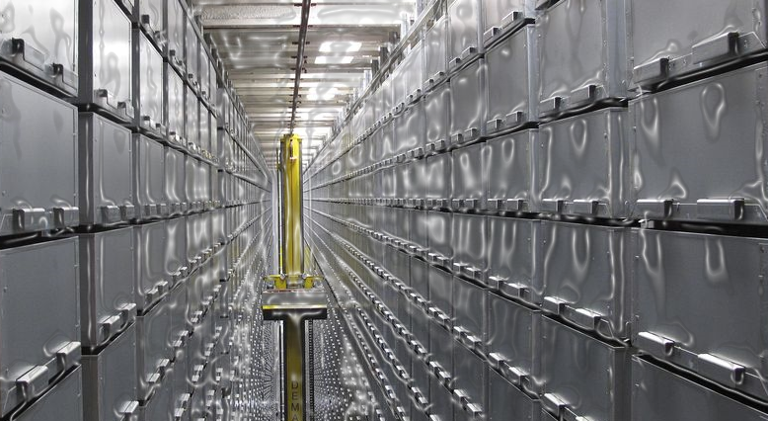
Pointers and Arrays

Slide 9
Think about this. If an array of 10000 integers is allocated (int data[10000]) how does the computer work out the location (address) of data[5341]?
Storing the address of every single element would be needlessly expensive (and actually make another similar sized problem).
The computer solves this problem by working out the address relative to the start of the array. Hence, for index i=3 in the array, the address is:
address_of_element[0]
+ i * sizeof(element_type)
0x??01 | 0x??02 | 0x??03 | 0x??04 | 0x??05 | 0x??06 | 0x??07 | 0x??08 | 0x??09 | 0x??0A | 0x??0B | 0x??0C | 0x??0D | 0x??0E | 0x??0F | 0x??10
00 | 00 | 00 | 00 | 00 | 00 | 00 | 00 | 00 | 00 | 00 | 00 | 00 | 00 | 00 | 00
Location to element[0]
Location of element[1]
Location of element[2]
Location of element[3]
Notes:
There is a very direct and close relationship between arrays and pointers.
Think about this. If an array of 100000 integers is allocated (int data[100000]) how does the computer work out the location (memory address) of data [56341]?
Storing the address of every single element would be needlessly expensive (and actually make another similar sized problem).
The computer solves this problem by working out the address by calculating the memory address relative to the start of the array. Hence, for index i in the array, the address is: address of element[0] + i * sizeof(element_type)

Slide 10
By using pointers and offsets it is possible to manipulate arrays in much the same way as you can using traditional indices:
1 | int data[10];
2 | int *ptrData = &data[0];
3
4 | int val_i = data[i]; // Both lines are
5 | int also_val_i = *(ptrData+i); // equivalent
But there is danger here. A subscript reference can be added to any pointer. e.g.
1 | int *ptrInt = &someInt;
2 | int valMystery = *(ptrInt+3); // Madness
3 | int also_Mystery = ptrInt[3]; // Madness
Both of the above are valid, even if ptrInt does not actually point to an array of data. It is up to the programmer to ensure meaningful access.
Notes:
By using pointers and offsets it is possible to manipulate arrays in much the same way as you can using traditional indices:
int data[10];
int *ptrData = &data;
then data[i] is the same as *(ptrData+i)
But there is danger here. A subscript reference can be added to any pointer. e.g.
int *ptrInt = &someInt;
ptrInt[3] is the same as *(ptrInt+3)
Both of the above is valid, even if ptrInt does not actually point to an array of data. It is up to the programmer to ensure correct working.

Slide 11

An array name and a pointer can be (mostly) used interchangeably.
Arrays are pointers, but not all pointers are arrays.
Pointers
Arrays
Notes:
An array name and a pointer can be (mostly) used interchangeably. As such, arrays are pointers, but not all pointers are arrays.

Slide 12

Recall that const permits the programmer to specify that a variable should not be modified. It can be used in different ways with pointers:
A pointer to constant data entails that the pointed-to value cannot be changed. A constant pointer entails that the pointed-to address cannot change.
Non-constant pointer to non-constant data
Non-constant pointer to constant data
Constant pointer to non-constant data
Constant pointer to constant data
Notes:
Recall const permits the programmer to specify that a variable should not be modified.
It can be used in different ways with pointers, namely:
nonconstant pointer to nonconstant data
nonconstant pointer to constant data
constant pointer to nonconstant data
constant pointer to constant data
A pointer to constant data entails that you can cannot use the pointer to change to the pointed-to value. A constant pointer entails that you cannot change where the pointer points to.

Slide 13
1 | int data = 10;
2 | const int *ptrData = &data;
Non-constant pointer to constant data
The value pointed to by ptrData is considered to be constant and cannot be changed through the pointer (Note: the original data might not be declared as const !)
1 | int data = 10;
2 | int * const ptrData = &data;
Constant pointer to non-constant data
The value pointed to by ptrData can be modified, but ptrData must always point to this value.
1 | int data = 10;
2 | const int * const ptrData = &data;
Constant pointer to constant data
Neither the pointer nor the pointed-to value can be changed. Yes, it does look somewhat odd.
Notes:
Non-constant pointer to constant data
int data = 10;
const int *ptrData = &data;
The value pointed to by ptrData is considered to be a constant and cannot be changed using the pointer (note: the original data might not actually be declared as const – this is more about what is permitted through using the pointer).
Constant pointer to non-constant data
int data = 10;
int * const ptrData = &data;
The value pointed to by ptrData can be modified, but ptrData must always point to this value.
Constant pointer to constant data
int data = 10;
const int * const ptrData = &data;
Neither the pointer nor the pointed-to value can be changed. Yes, it does look somewhat odd.

Slide 14

When to Use CONST
The principle of least privilege states that you should give a function enough access to the data it requires to accomplish its specified task, but no more. This this sage advice.
const is often encountered when passing pointers as function arguments.
This helps protect against functions inadvertently changing data (it’s safer). It also entails that both const and non-const arguments can be passed to the function (a const variable cannot be directly passed to as a non-const function parameter).
Notes:
The principle of least privilege states that you should give a function enough access to the data it requires to accomplish its specified task, but no more.
As such, const is often encountered when passing pointers as function arguments.
This helps project against functions inadvertently changing data (it’s safer). It also entails that both const and non-const arguments can be passed to the function (a const variable cannot be directly passed to as a non-const function parameter).
Aside: Generally const is only applied to the pointed-to values of the function parameters and not the actual pointers themselves. Changing shared data is typically more of an issue than reading shared data.

Slide 15
As pointers are just memory addresses it’s possible to reinterpret what a pointer pointers to using static_cast<> which will attempt (at compile time) the specified recast.
Assume Circle and Shape are classes linked via inheritance. Then:
Aside: A dynamic_cast<> can also be used to perform runtime-checked up and down casting within an inheritance hierarchy (i.e. safer but slower).
1 | Circle *ptrCircle = new Circle();
2 | Shape *ptrShape = static_cast<Shape>(*ptrCircle); // Valid cast
3 | int *ptrInt = static_cast<int>(*ptrCircle); // Won’t compile, invalid cast
Notes:
As pointers are just memory address it’s possible to reinterpret what a pointer pointers to using a cast.
The recommended means of doing this is to use a static_cast<> which will permit the pointer type to recast if it is a type of the object being cast to.
Assuming Cricle and Shape are two classes linked through inheritance. Then the following holds:
Circle *ptrCircle = new Circle();
Shape *ptrShape = static_cast<Shape>(ptrCircle); // Valid downcast
int *ptrInt = static_cast<int>(ptrCircle); // Won’t compile, invalid cast
Aside: A dynamic_cast can also be used to perform runtime up and down casting within an inheritance hierarchy.
Aside: Old style C casts can also be used (but are more dangerous!)

Slide 16
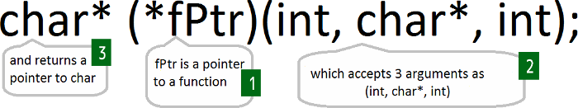
Functions (a sequence of machine instructions stored at a location in memory) also have addresses.
In some cases it can be useful to have a pointer to a function. This permits functions to be passed as arguments to other functions. This can be useful for things such as sorting where a flexible comparison function is needed.
Notes:
Functions (a sequence of machine instructions stored in a location in memory) also have addresses.
In some cases it can be useful to have a pointer to a function. This permits functions to be passed as arguments to other functions. This can be useful for things such as sorting where a flexible comparison function needs to be specified.

Slide 17

If a smart pointer goes out of scope (i.e. is deleted) then it will additionally take some action. Often this is a check to see if it should also delete (free up) whatever it was pointing to (e.g. dynamically allocated memory).
This helps to avoid memory leaks.
Smart pointers are often written as a template class that overrides the -> and * (dereference) operators, i.e. they are classes that act like pointers.
Notes:
Smart pointers provide additional behaviour. Typically, if a smart pointer goes out of scope (i.e. is deleted) then it will additionally take some action to see if it should also delete (free up) whatever it was pointing to (e.g., dynamically allocated memory). This helps to avoid memory leaks.
Smart pointers are typically written as a template class that overrides the -> and * (dereference) operators, i.e. they are classes that act like pointers.

Slide 18
The C++ Standard Library offers the following smart pointers:
unique_ptr
Uniquely refers to an item which is deleted when the pointer goes out of scope.
shared_ptr
Reference-counted smart pointer. The raw pointer is deleted when all shared pointers go out of scope.
1 | void RawPointer()
2 | {
3 | SomeClass ptrObj = new SomeClass();
4 | // Use ptrObj
5 | delete ptrObj; // Don’t forget!
6 | }
1 | void SmartPointer()
2 | {
3 | unique_ptr<Someclass> ptrObj(new SomeClass());
4 | // Use ptrObj
5 | } // Object freed with ptrObj
Notes:
The C++ Standard Library offers the following smart pointers:
unique_ptr – pointer uniquely refers to the pointed-to item which is deleted when the pointer goes out of scope (default choice for plain old C++ objects (POCO)).
shared_ptr - reference-counted smart pointer. More than one smart pointer can point to a given item. The raw pointer is deleted when all shared pointers go out of scope.
void RawPointer()
{
SomeClass ptrObj = new SomeClass();
// use ptrObj;
delete ptrObj; // don’t forget to do this
}
void SmartPointer()
{
unique_ptr<SomeClass> ptrObj(new SomeClass());
// use ptrObj;
} // Object automatically free alongside ptrObj

Slide 19

References

Slide 20

A reference is an alias for another variable. Modifying the reference changes the value to which it refers.
Reference variables must be assigned as soon as they are created.
1 | int val = 0;
2 | int &refVal = val;
3 | int &refOtherVal; // Won’t compile
So what’s the difference between a pointer and a reference?
A reference is a named constant for a given address (more or less a non-null const pointer). References are automatically (implicitly) dereferenced whilst pointers must be explicitly dereferenced (using the indirection operator, *)
Notes:
A reference is basically an alias for another variable. Modifying the reference changes the value to which it refers.
You can create stand-alone reference variables, use reference data members in classes, accept references as parameters to functions and methods and return references from functions and methods.
Reference variables must be assigned as soon as they are created.
int val = 0;
int &refVal = val;
int &refOtherVal; // Won’t compile
So what’s the difference between a pointer and a reference?
Basically a reference is a named constant for a given address (more or less a non-null const pointer). References are automatically or implicitly dereferenced whilst pointers must be explicitly dereferenced (using the indirection operator, *)

Slide 21

Deciding Between References and Pointers
Functionally references and pointers are basically the same. Although references may provide cleaner code that is more easy to understand.
References are also somewhat safer than pointers (cannot be null, no dereferencing errors).
Ideally you should favour references over pointers unless you need to dynamically allocate/free memory or actively alter the value of the pointer.
Notes:
What you can do with a reference you can also do with a pointer. Although sometimes using references will result in cleaner code that is more easy to understand (remember this is important!).
References are also somewhat safer than pointers (cannot be null, no dereferencing errors).
Ideally you should favour references over points unless you need to dynamically allocate/free memory or actively alter the value of the pointer (e.g. stepping through an array).
Be careful to never return a reference to a variable allocated on the stack will later be destroyed.

Slide 22

Key takeaways:
Pointers are wonderfully powerful.
They provide a flexible means of manipulating data stored in memory.
Although, with great power comes great responsibility. Care should be taken to ensure safe pointer usage.
In particular, code should be written so that the meaning is apparent in the eye of the beholder.

